Slide 1
Solar Irradiance Forecasting System
Minor Project

Slide 2
INTRODUCTION
Welcome to our presentation on Solar Irradiance Forecasting using Deep Learning Algorithms. In the realm of renewable energy, solar power stands as a beacon of hope, offering clean and sustainable electricity generation. However, the inherent variability of solar irradiance poses significant challenges to its widespread adoption. Our project addresses this challenge by harnessing the power of DEEP learning algorithms, alongside innovative features such as Time- Stamp and Hexagon- Grid systems, to improve the accuracy of solar irradiance predictions.

Slide 3
Literature Review
LSTM-CNN Models:
The document highlights the utilization of deep long short-term memory-convolutional neural network (LSTM-CNN) models optimized by a modified whale optimization algorithm for forecasting solar irradiance datasets.
Ensemble Strategy:
An ensemble strategy based on a deep reinforcement learning algorithm is used to select the best of combined deep-optimized LSTM-CNN models for improved forecasting performance.
Deep Learning:
Deep learning techniques, including CNNs, RNNs, LSTMs, and attention models, have revolutionized various fields by enabling the automatic discovery of complex patterns and representations from raw data.

Slide 4

Problem Statement
Traditional linear methods are inadequate, prompting a model for precise predictions with both linear and non-linear capabilities.
Current methods neglect bias, impacting solar irradiance prediction reliability.
Limited accuracy and reliability, particularly in capturing short-term fluctuations and sudden changes in solar irradiance.

Slide 5



Reasearch gap
Research Gap
Hyperparameter Optimization Challenges:
Sparse research on optimizing hyperparameters of LSTM-CNN models using evolutionary algorithms like grid search.
Image Processing :
To automatically extract relevant features from satellite imagery, such as cloud types, motion, and density.
Ensemble Strategy Optimization:
Scarce investigation into reinforcement learning strategies, such as Q-learning, for selecting optimal subsets of LSTM-CNN models in ensemble forecasting.

Slide 6

Objectives
Model combining linear and non-linear capabilities.
Addressing bias neglect and traditional model limitations
Overcoming chaos associated with solar power fluctuations.
Comprehensive testing and comparison.
Enhanced spatial resolution utilizing hexagon grid system.

Slide 7
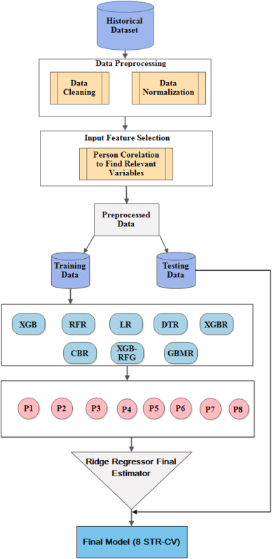
Historical Data Set
Data Processing
Data Cleaning
Data Normalization
Training Data
Testing Data

Slide 8
Proposed mechanism
Feature Engineering: Integration of hourly solar irradiance data spanning 24 years, meteorological variables, and time-related features.
Hexagon Grid System: Implementation of a hexagon grid system to capture spatial dependencies. Utilizing timestamps to predict how weather conditions in one area affect nearby regions and determine when similar weather patterns will occur.
Model Selection: Adoption of a hybrid approach combining Convolutional Neural Network (CNN), Long Short-Term Memory (LSTM) based Recurrent Neural Network (RNN), and Deep Autoregressive (Deep AR) models.

Slide 9
Hybrid Approach: Fusion of CNN and LSTM for spatial-temporal pattern recognition, attention mechanism for feature focusing, and deep autoregressive models for long-term dependencies.
Training Strategy: Utilization of Adam optimizer, batch training with mini-batch sizes, and learning rate scheduling for efficient convergence and generalization.
Evaluation and Validation: Rigorous validation through data splitting, evaluation metrics calculation (R², RMSE, MAE, MSE), and cross-validation techniques for robustness assessment.

Slide 10
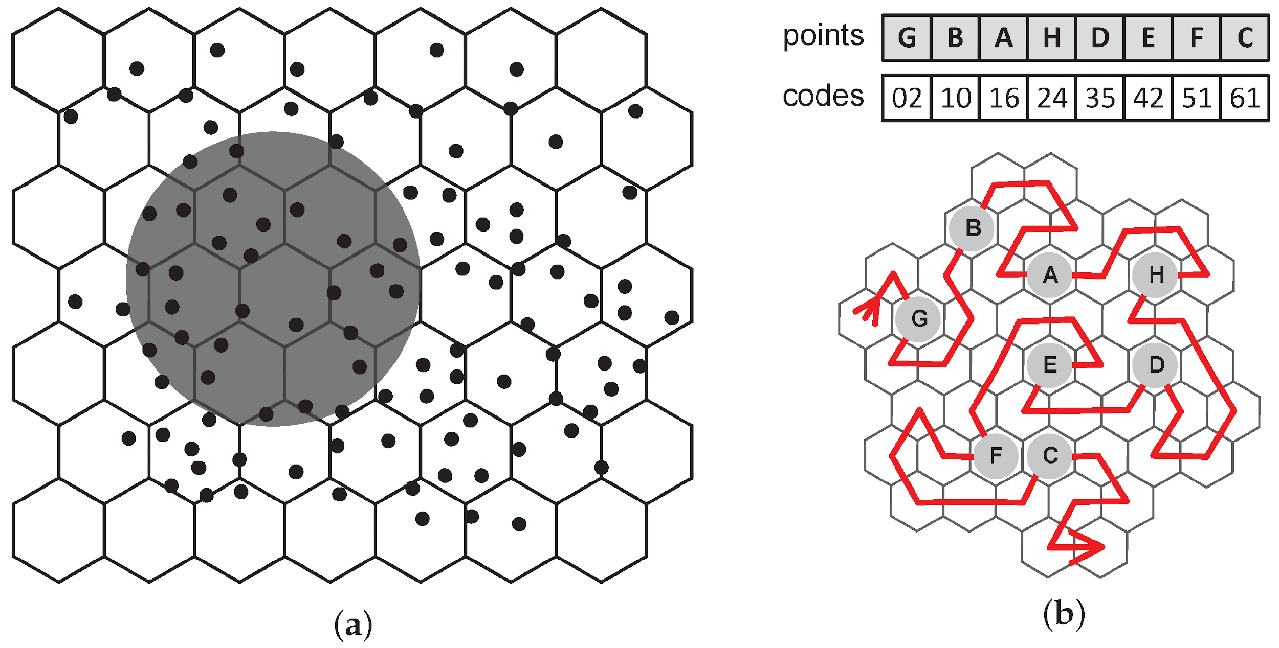
Proposed mechanism
Data from multiple sites surrounding the target location is analyzed using a hexagon gridding system.
Correlation and feature importance help select relevant features.
A novel residual ensemble forecast mechanism, blending linear and non-linear characteristics, is developed for accurate predictions.

Slide 11
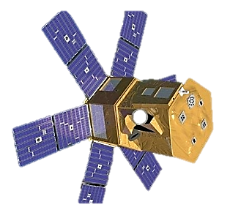
Collecting historical daily solar irradiance data from NASA's POWER project, to Develop deep learning forecast models with recurrent neural networks, convolutional neural networks, and attention mechanisms. Evaluating forecast performance using metrics like mean squared error, root-mean-square error, and coefficient of determination.

Slide 12
Hybrid Forecast Mechanism
Linear & Non-linear Combination
Integrating both linear and non-linear modeling techniques to leverage their respective strengths.
Linear models capture simple relationships and trends, while non-linear models capture complex patterns and interactions.
Linear components: Linear regression, autoregressive models (AR), or moving average models (MA).
Non-linear components: Artificial neural networks (ANN), support vector machines (SVM), or decision trees.
Integration techniques: Weighted averaging, ensemble methods

Slide 13
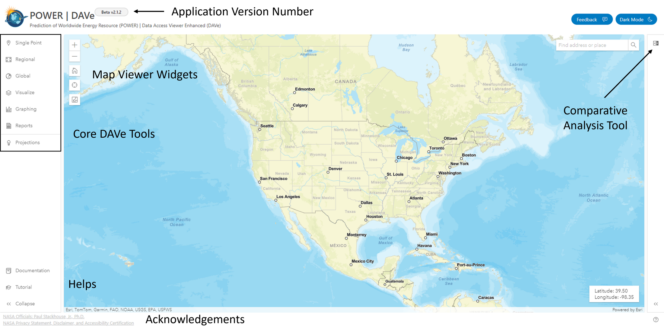
Data Set from POWER Project of NASA
Core DAV Tools : to download and interact with POWER data.
Map Viewer Widgets include interactive mapping functionality.
Application Version Number provides a snapshot in time and functionality.
Comparative Analysis Tool to visualize POWER data as layers in the map

Slide 14
Models Used
Convolutional Neural Network (CNN)-CNNs are effective at capturing spatial relationships, making them suitable for analyzing weather data across geographical areas and identifying features relevant to solar irradiance
Linear Regression-Linear regression provides a simple yet interpretable model for forecasting solar irradiance based on historical weather and solar data. It serves as a baseline for comparison with more complex models.
Long Short-Term Memory (LSTM) based Recurrent Neural Network (RNN)-In solar irradiance forecasting, LSTMs are valuable for capturing temporal dependencies in weather data, such as daily and seasonal patterns, which are crucial for accurate predictions.

Slide 15
Attention Mechanism- In solar irradiance forecasting, attention mechanisms can help the model prioritize important features in weather data, such as cloud cover and humidity levels, improving forecast accuracy by focusing on relevant factors.
CNN-LSTM Hybrid Model-This model architecture is well-suited for solar irradiance forecasting as it can effectively analyze both spatial and temporal patterns in weather data, resulting in more accurate predictions.
Deep Autoregressive (Deep AR) Model-Deep AR models can capture complex temporal patterns in solar irradiance data, making them suitable for long-term forecasting and handling nonlinear relationships between weather variables and solar irradiance.

Slide 16
Results
Cold Season
Seasons | Models | R2 | RMSE | MSE | MAE
Cold Season | CNN | 0.99998090 | 0.756284 | 0.5719658 | 0.5541902
 | LSTM based RNN | 0.94253 | 56.68928 | 3213.67499 | 33.37367
 | Attention | 0.9999689264 | 1.3006049080 | 1.6915731268 | 1.1399121359
 | CNN-LSTM | 0.938704603 | 0.061909632 | 0.0038328025 | 0.034225500
 | Deep AR
 | Linear Regression | 0.926931 | 64.00975 | 4097.249087 | 46.1320199

Slide 17
Monsoon Season
Seasons | Models | R2 | RMSE | MSE | MAE
Monsoon Season | CNN | 0.999980902 | 0.756284263 | 0.571965887 | 0.55419021205
 | LSTM based RNN | 0.88499 | 95.89659 | 9196.15643 | 58.38278
 | Attention | 0.99994768550
 | CNN-LSTM | 0.886586706 | 0.10263399840 | 0.010533737 | 0.0593065843
 | Deep AR
 | Linear Regression | 0.953292078 | 65.36518877 | 4272.6079038 | 47.27920854

Slide 18
Post- Monsoon Season
Seasons | Models | R2 | RMSE | MSE | MAE
Post – Monsoon Season | CNN | 0.999980902 | 0.7562842635 | 0.5719658873 | 0.55419021205
 | LSTM based RNN | 0.94406 | 72.63597 | 5275.98358 | 40.89450
 | Attention
 | CNN-LSTM | 0.9590821879 | 0.0583215770 | 0.003401406 | 0.0281191126
 | Deep AR
 | Linear Regression | 0.95701844013 | 50.60405825 | 2560.770711 | 30.0277011817

Slide 19
Summer Season
Seasons | Models | R2 | RMSE | MSE | MAE
Summer Season | CNN | 0.9999809 | 0.756284263 | 0.5719658873 | 0.55419021205
 | LSTM based RNN | 0.94406 | 72.63597 | 5275.98358 | 40.89450
 | Attention
 | CNN-LSTM | 0.93999596075 | 0.0767972785 | 0.04020781583 | 0.0058978219875
 | Deep AR
 | Linear Regression | 0.95329207 | 65.36518877 | 4272.607903 | 47.279208548

Slide 20

Conclusions
Utilizing multi-site data enhances solar irradiance forecasting, with the proposed residual ensemble learning approach improving prediction error.
Integrating convolutional and attention-based LSTM layers significantly enhances solar irradiance forecasting accuracy.
Bias-variance evaluation enhances model robustness and generalizability, making it valuable for real-world solar power plant planning and deployment.
The proposed methodology emphasizes accuracy, performance, and reliability, showing promising advancements in solar energy forecasting,

Slide 21
References
1. Brahma, B., & Wadhvani, R. (2023). A residual ensemble learning approach for solar irradiance forecasting. Multimedia Tools and Applications. Advanced online publication.
https://doi.org/10.1007/s11042-023-14616-6
2. Neha Sehrawat ,Sahil Vashisht ,Amritpal Singh (2023). Solar irradiance forecasting models using machine learning techniques and digital twin: A case study with comparison.
https://doi.org/10.1016/j.ijin.2023.04.001
3. Brahma, B., & Wadhvani, R. (2020). Solar irradiance forecasting based on deep learning methodologies and multi–site data. Symmetry, 12(11), Article 1826.
https://doi.org/10.3390/sym12111830
4. Ameera M. Almarzooqi, Maher Maalouf, Tarek H.M. El-Fouly, Vasileios E. Katzourakis, Mohamed S. El Moursi and Constantinos V. Chrysikopoulos (2024) A hybrid machine-learning model for solar irradiance forecasting.
https://doi.org/10.1093/ce/zkad075

Slide 22
Thank You !!

